Slide 1
Sprint 4
Clustering and topic modeling

Slide 2
Module overview
Task:
Discover groups (clusters) of related articles
Topic modeling
Core concepts
Algorithms and models
Implementation on real dataset
Unsupervised learning
Cluster heterogeneity
K-means
LDA
Wikipedia
Sprint 4 – Clustering and topic modeling

Slide 3
Task : Clustering documents without labels
Sprint 4 – Clustering and topic modeling

Slide 4
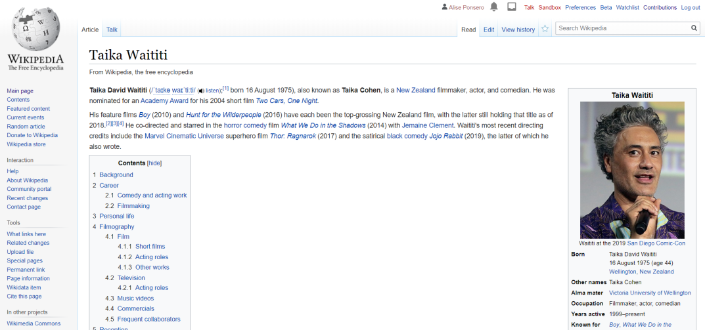
Task description
Reading a document of interest
How do I find other documents on the same topic ?
Can I retrieve all documents that are on this topic ?
Sprint 3 - Retrieval

Slide 5
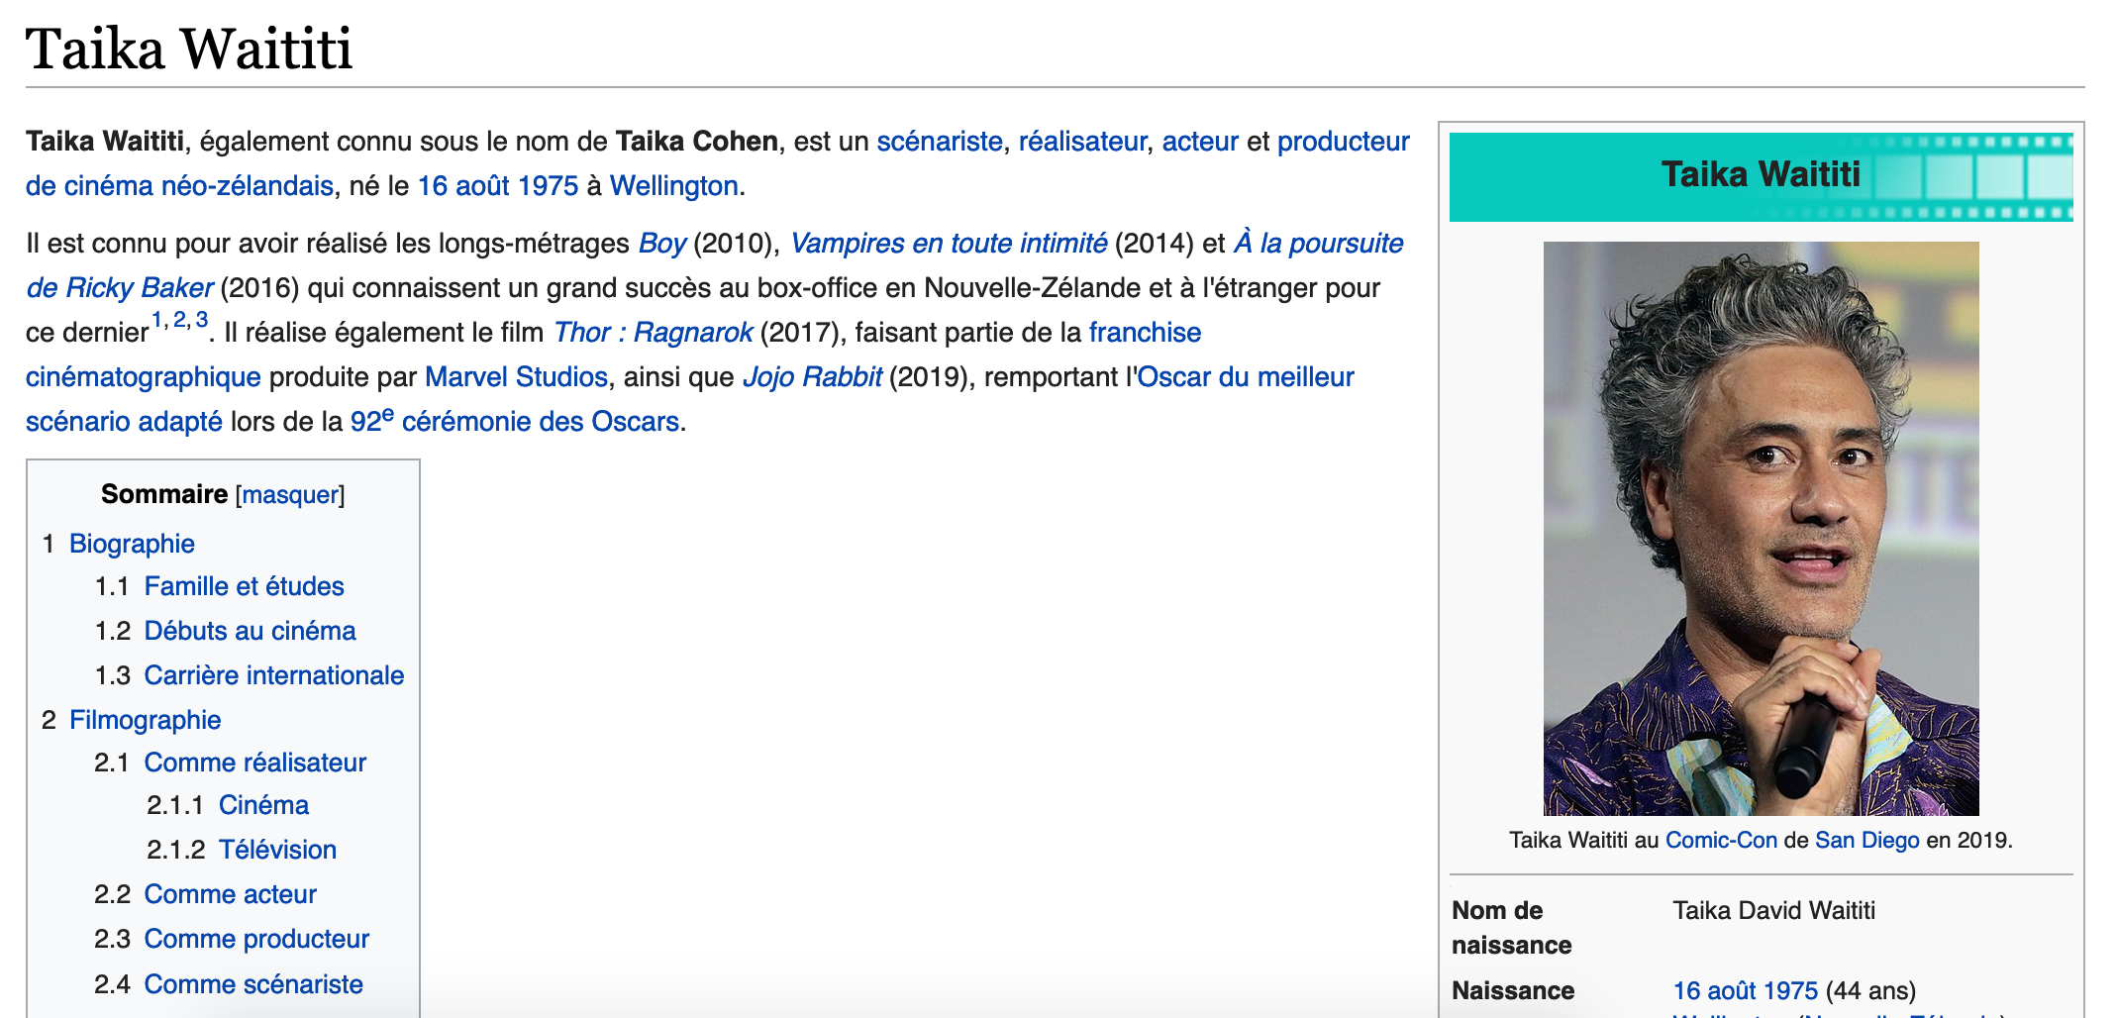
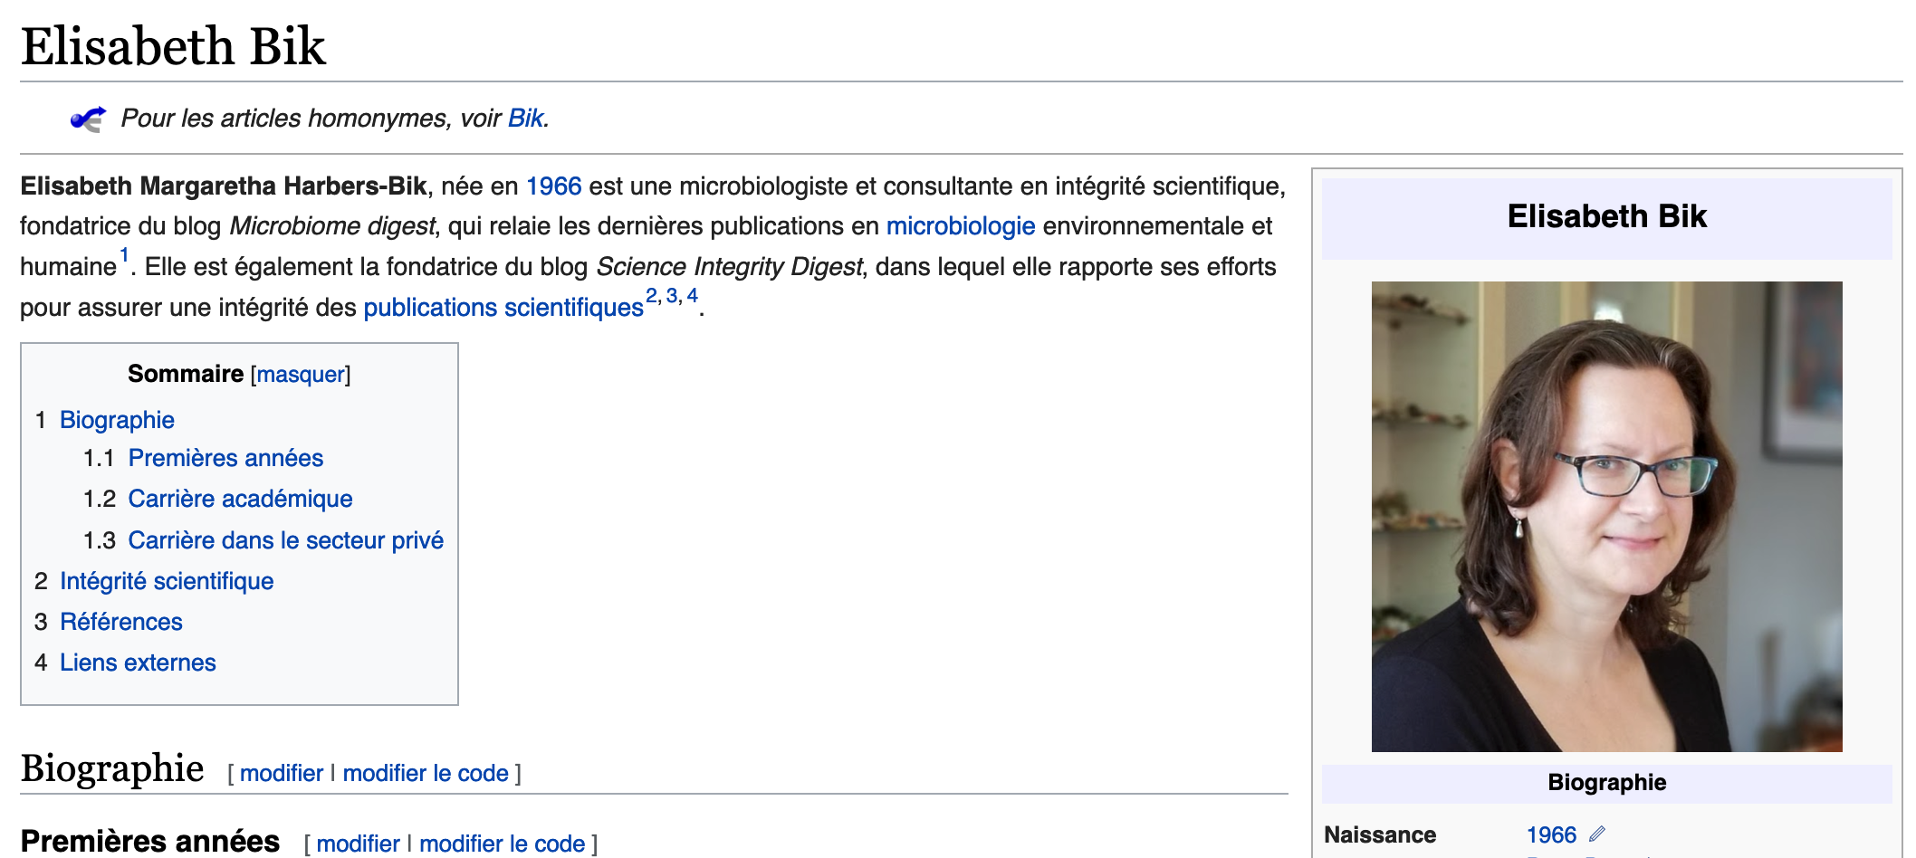
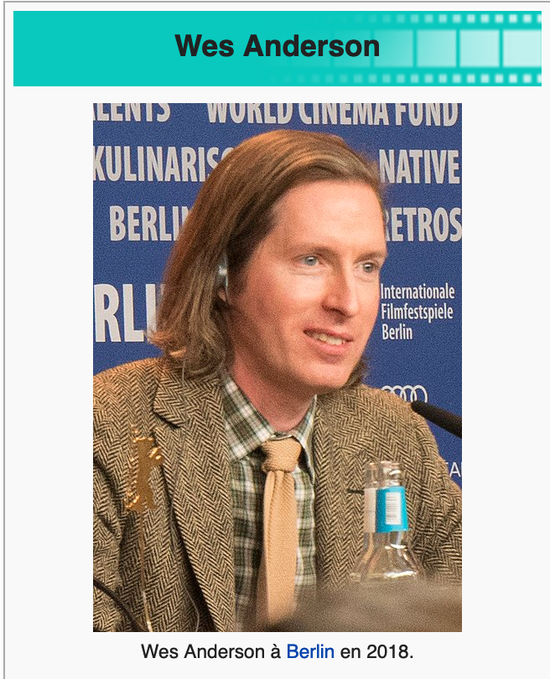
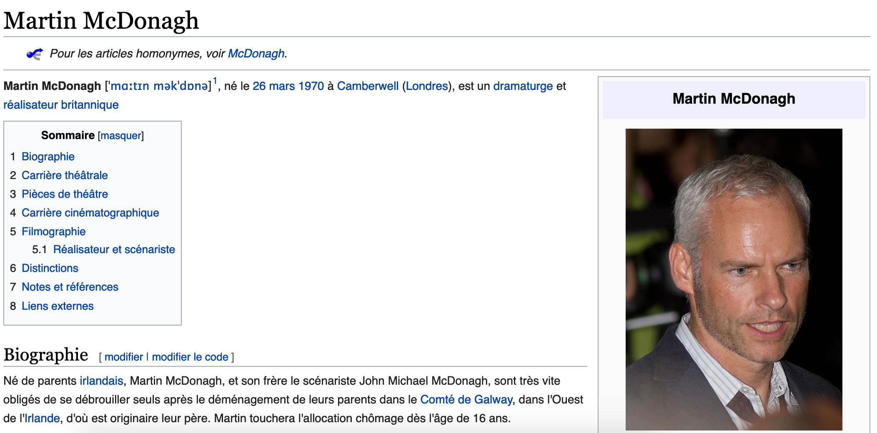
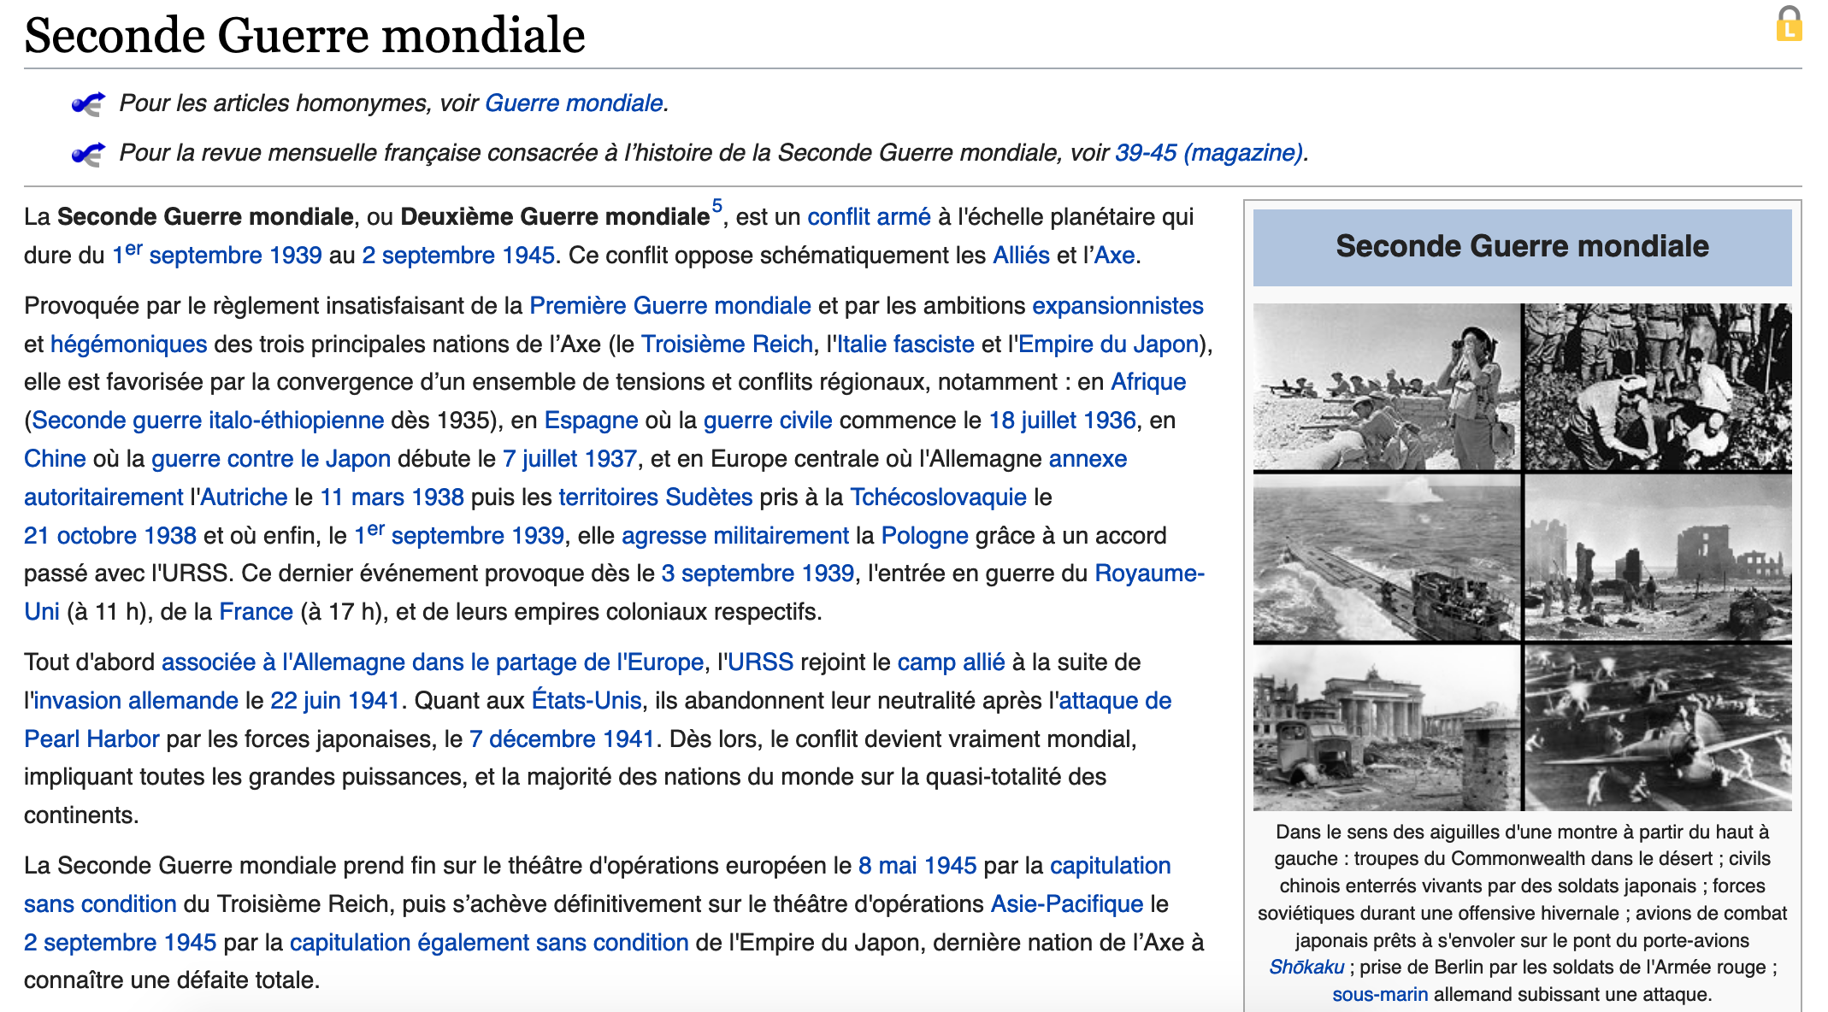
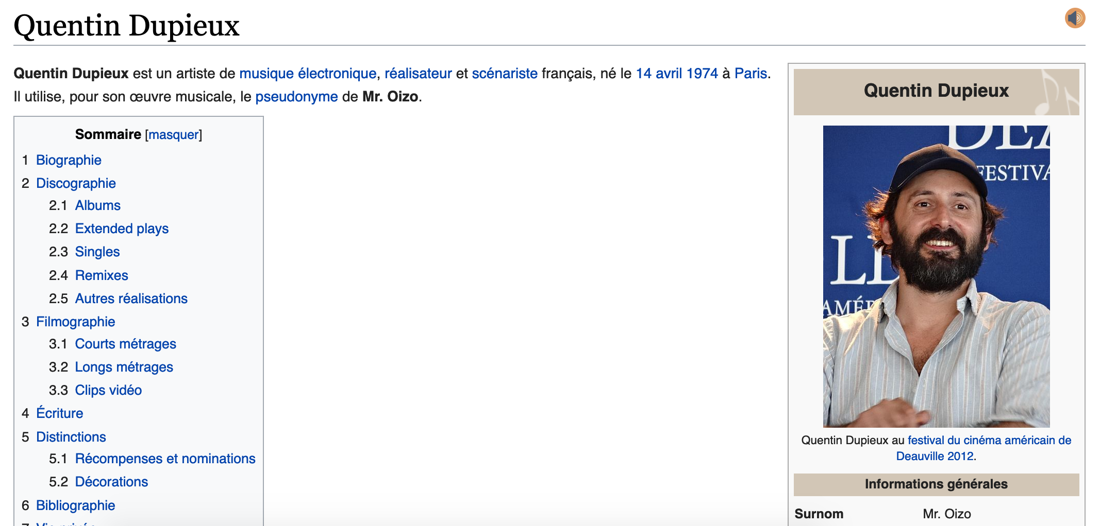
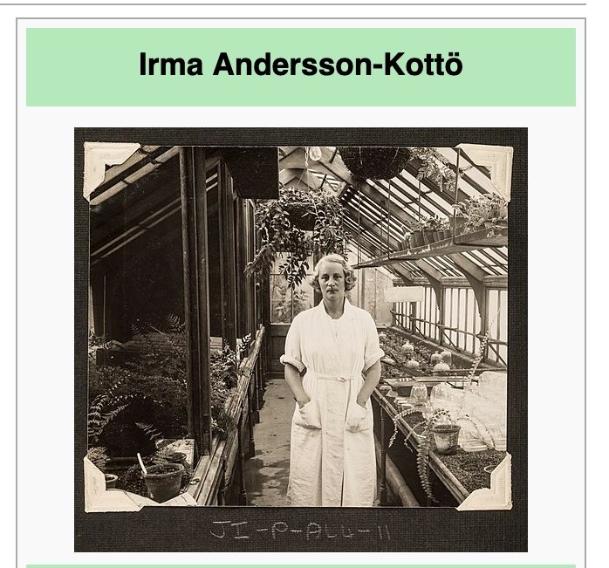

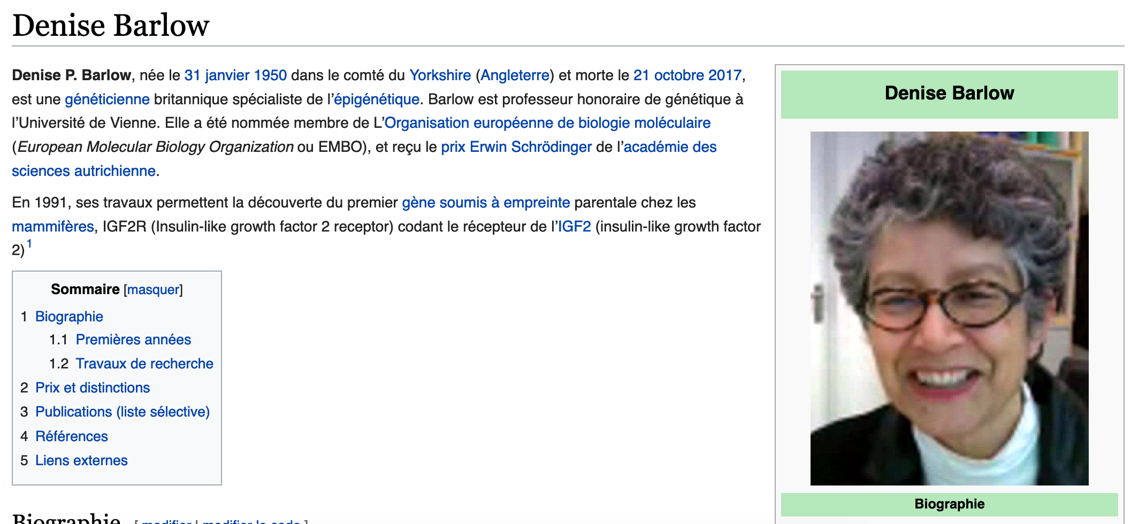
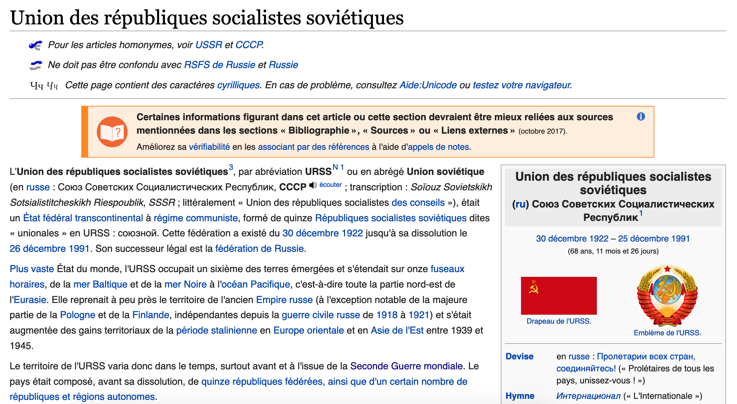
Task description
Clustering goal: Discover groups of related documents
Sprint 3 - Retrieval

Slide 6
Task description
Clustering goal: Discover groups of related documents
Sprint 3 - Retrieval

Slide 7
Clustering
No labels provided, we want to uncover the cluster structure from input alone
Input: Wikipedia articles as vectors x_{i}
Output: Cluster labels z_{i}
Feature 2
Unsupervised learning task
Feature 1
Sprint 4 – Clustering and topic modeling

Slide 8
Concepts: Unsupervised learning
Sprint 4 – Clustering and topic modeling

Slide 9
What defines a Cluster?
Clusters defined by a center (centroid), shape and a spread
Once the clusters are defined, we can calculate a score to assign observations x_{i} to the closest cluster k
Feature 2
x_{i}
Feature 1
Sprint 4 – Clustering and topic modeling

Slide 10
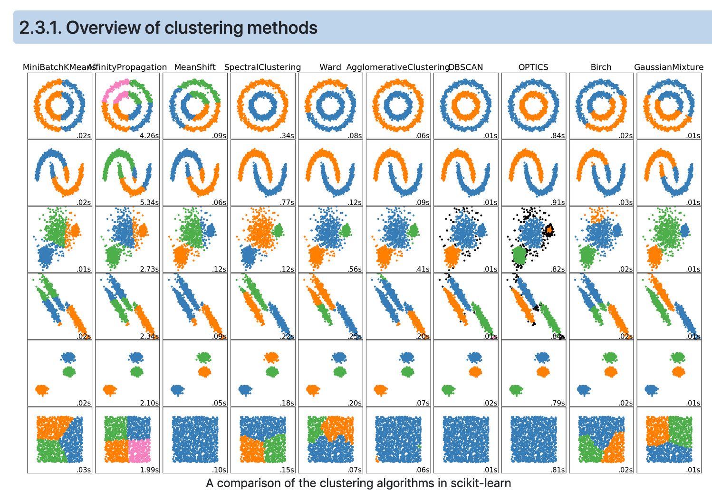
Cluster shapes and clustering algorithms
Sprint 4 – Clustering and topic modeling

Slide 11
Algorithm: k-means
Sprint 4 – Clustering and topic modeling

Slide 12
K-means
1- Initialize cluster centers (μ1, …, μk)
Feature 2
Feature 1
Sprint 4 – Clustering and topic modeling

Slide 13
K-means
1- Initialize cluster centers (μ1, …, μk)
Feature 2
k=3
Feature 1
Sprint 4 – Clustering and topic modeling

Slide 14
K-means
1- Initialize cluster centers (μ1, …, μk)
2- Assign observations to the closest cluster center
z_{i} <- arg min || μ_{j} – x_{i}||
3- Revise cluster centers as mean of assigned observations
μ_{j} = (1/N) ∑ x_{i}
4- Repeat 1-2 until convergence
Feature 2
k=3
i:z_{i} = j
Feature 1
Sprint 4 – Clustering and topic modeling

Slide 15
K-means
1- Initialize cluster centers (μ1, …, μk)
2- Assign observations to the closest cluster center
z_{i} <- arg min || μ_{j} – x_{i}||
3- Revise cluster centers as mean of assigned observations
μ_{j} = (1/n_{j}) ∑ x_{i}
4- Repeat 1-2 until convergence
Feature 2
k=3
i:z_{i} = j
Feature 1
Sprint 4 – Clustering and topic modeling

Slide 16
K-means
1- Initialize cluster centers (μ1, …, μk)
2- Assign observations to the closest cluster center
z_{i} <- arg min || μ_{j} – x_{i}||
3- Revise cluster centers as mean of assigned observations
μ_{j} = (1/n_{j}) ∑ x_{i}
4- Repeat 1-2 until convergence
Feature 2
k=3
i:z_{i} = j
Feature 1
Sprint 4 – Clustering and topic modeling

Slide 17
K-means
1- Initialize cluster centers (μ1, …, μk)
2- Assign observations to the closest cluster center
z_{i} <- arg min || μ_{j} – x_{i}||
3- Revise cluster centers as mean of assigned observations
μ_{j} = (1/n_{j}) ∑ x_{i}
4- Repeat 1-2 until convergence (local optimum)
Feature 2
k=3
i:z_{i} = j
Feature 1
Coordinate descent :
2 -> Minimizing z given μ
3 ->Minimizing μ given z
Sprint 4 – Clustering and topic modeling

Slide 18
K-means
The cluster centers’ initialization critical to quality of the local optima found
1- Initialize cluster centers (μ1, …, μk)
2- Assign observations to the closest cluster center
z_{i} <- arg min || μ_{j} – x_{i}||
3- Revise cluster centers as mean of assigned observations
μ_{j} = (1/n_{j}) ∑ x_{i}
4- Repeat 1-2 until convergence (local optimum)
Feature 2
k=3
i:z_{i} = j
Feature 1
Coordinate descent :
2 -> Minimizing z given μ
3 ->Minimizing μ given z
Sprint 4 – Clustering and topic modeling

Slide 19
K-means++
Smart initialization:
Choose first cluster center uniformly at random from data point
For each xi, compute the distance d(x_{i}) to the nearest cluster center
Choose new luster center among the remaining datapoints, with probability of x_{i} being chosen proportional to d(x_{i})²
Feature 2
Feature 1
Sprint 4 – Clustering and topic modeling

Slide 20
K-means++
Smart initialization:
Choose first cluster center uniformly at random from data point
For each xi, compute the distance d(x_{i}) to the nearest cluster center
Choose new luster center among the remaining datapoints, with probability of x_{i} being chosen proportional to d(x_{i})²
Feature 2
Feature 1
Sprint 4 – Clustering and topic modeling

Slide 21
K-means++
Smart initialization:
Choose first cluster center uniformly at random from data point
For each xi, compute the distance d(x_{i}) to the nearest cluster center
Choose new luster center among the remaining datapoints, with probability of x_{i} being chosen proportional to d(x_{i})²
When the number of cluster k is reached, run k-means as previously described
Feature 2
Feature 1
Sprint 4 – Clustering and topic modeling

Slide 22
Concepts: Cluster heterogeneity
Sprint 4 – Clustering and topic modeling

Slide 23
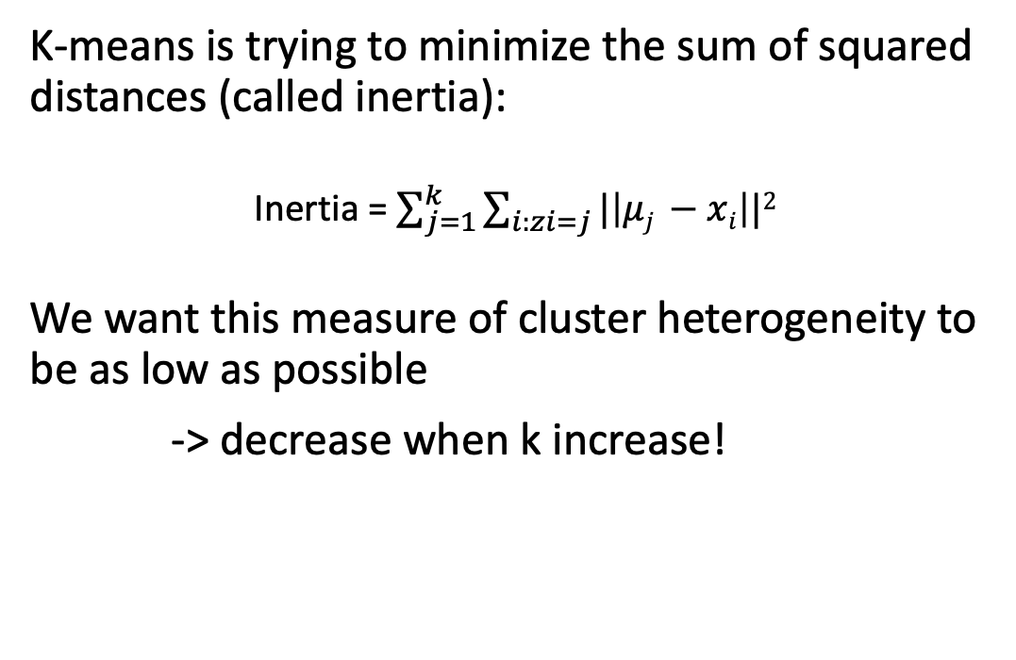
Assessing the quality of clusters
K-means is trying to minimize the sum of squared distances (called inertia):
Inertia = $\sum_{j=1}^{k}{\sum_{i:zi=j}{|\left|μj −xi\right||2}}$
We want this measure of cluster heterogeneity to be as low as possible
-> decrease when k increase!
Feature 2
Feature 1
Sprint 4 – Clustering and topic modeling
Notes:
Minimize the the sum of squared distances from points to their centroid

Slide 24
How to choose k ? The “Elbow method”
Inertia
Choose this k!
There is no right answer, this is just a heuristic
k
Importantly :
Because k-means aims to reduce the inertia -> k-means makes the assumption that clusters are convex and isotropic. It responds poorly to elongated clusters, or manifolds with irregular shapes.
Sprint 4 – Clustering and topic modeling
Notes:
Minimize the the sum of squared distances from points to their centroid

Slide 25
Implementation: Understanding initialization impact on convergence
Sprint 4 – Clustering and topic modeling

Slide 26
Task1 : impact of initialization on convergence
Open the jupyter notebook for the sprint
In this task, we’ll
Generate random clusters
Look at the impact of initialization methods on getting the right clusters using kmeans
Sprint 4 – Clustering and topic modeling
Notes:
Minimize the the sum of squared distances from points to their centroid

Slide 27
Implementation: wikipedia pages
Sprint 4 – Clustering and topic modeling

Slide 28
Task2: Define clusters of Wikipedia articles
Open the jupyter notebook for this week
In this task, we’ll
Load the New Zealand biography dataset and compute the TF-IDF (again)
Choose a k for using the “Elbow method”
Compute the clusters and retrieve the documents in the cluster of interest
Sprint 4 – Clustering and topic modeling
Notes:
Minimize the the sum of squared distances from points to their centroid

Slide 29
Task : Mixed membership modeling with LDA
Sprint 4 – Clustering and topic modeling

Slide 30
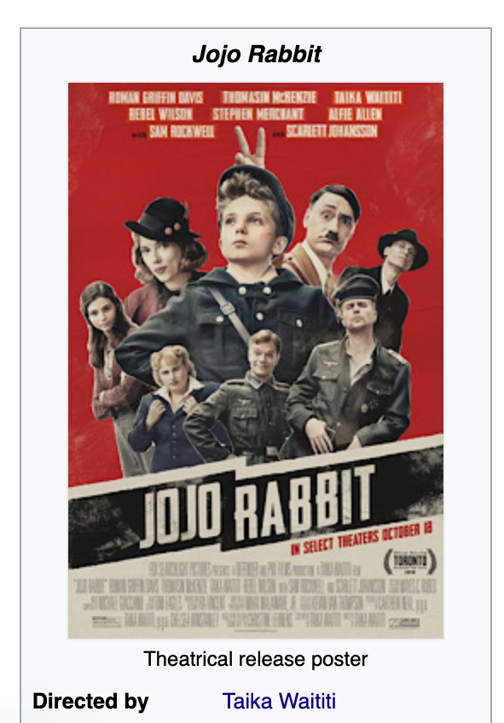
Task description
Clustering goal: Discover groups of related documents
Sprint 3 - Retrieval

Slide 31
Task description
What if we have an article on two topics?
Sprint 3 - Retrieval

Slide 32
Task description
Mixed membership models:
Allow to discover a set of membership
Sprint 3 - Retrieval

Slide 33
Algorithm: LDA
Sprint 4 – Clustering and topic modeling

Slide 34
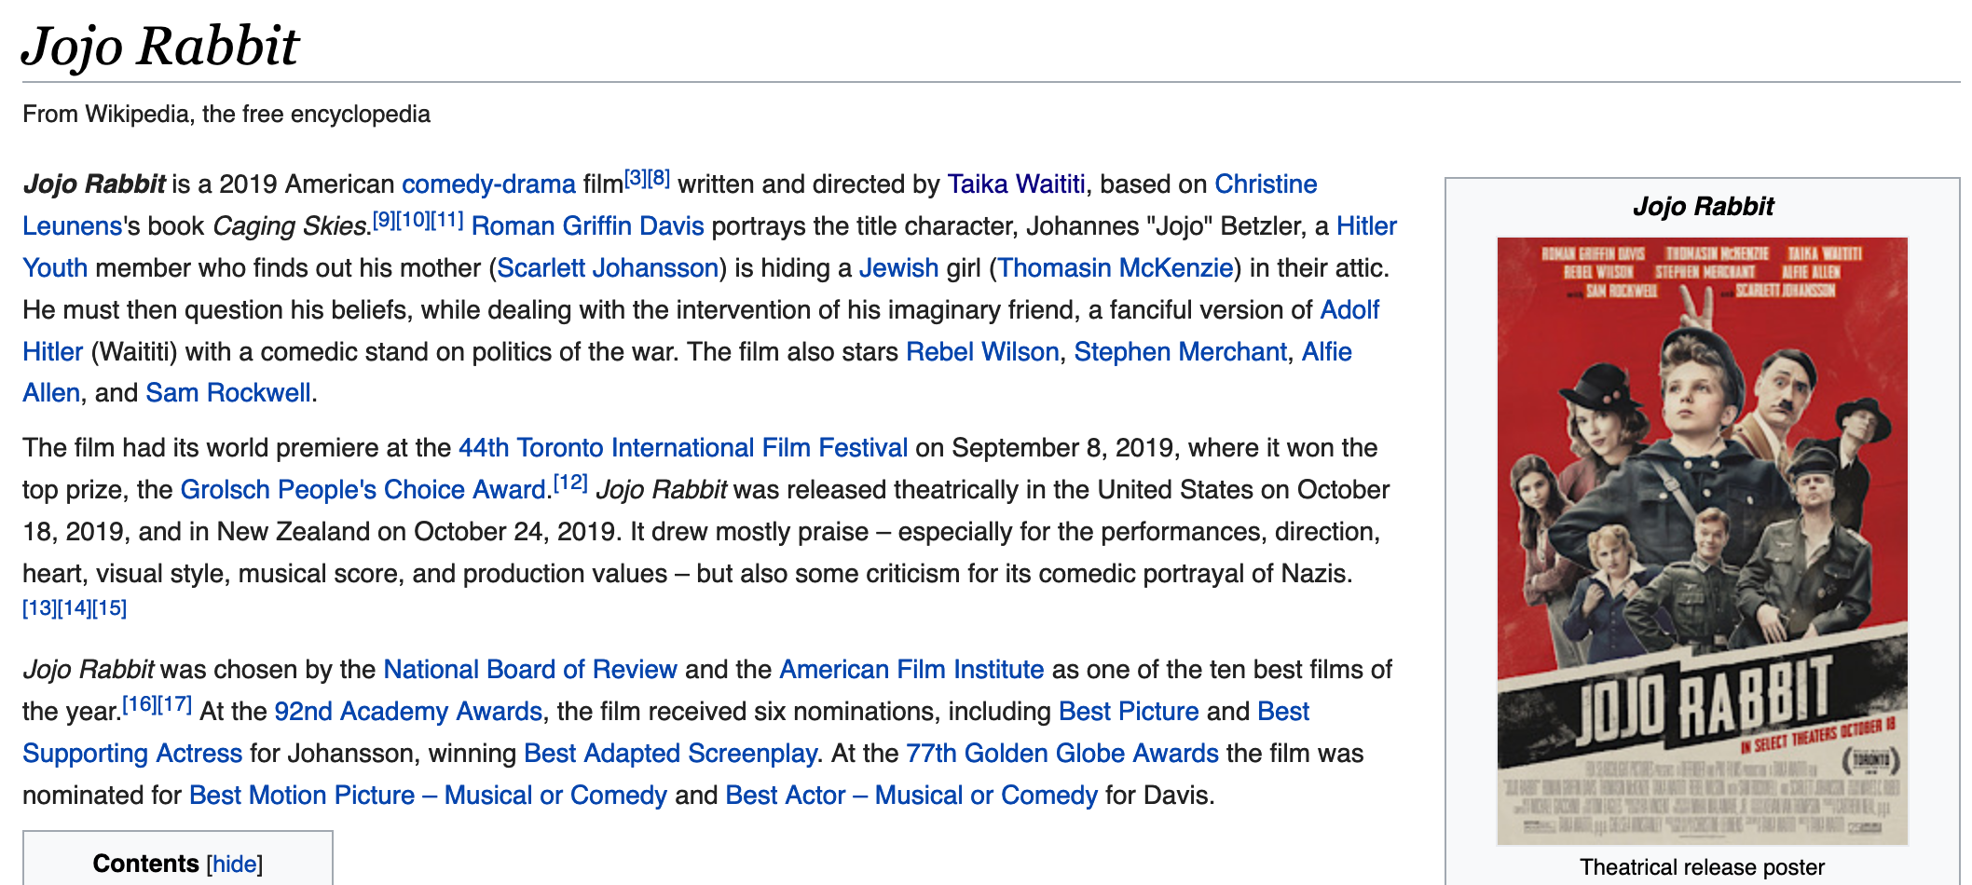
Goal of LDA
LDA is a mixed membership model
We want to discover a set of topics associated with the document
To do so the model will define a topic vocabulary distribution
Topic 1
Film | 0.1
movie | 0.09
Topic 2
music | 0.02
score | 0.07
Topic 3
war | 0.07
Hitler | 0.1
Topic 4
team | 0.09
soccer | 0.05
Sprint 4 – Clustering and topic modeling

Slide 35
LDA
Capture the range of topics in the corpus
Choose the set of words associated to each topic
Associate documents to topics
Normally LDA is specified as a Bayesian model
(Otherwise called ”probabilistic latent semantic analysis)
Gibbs sampling
Iterative random hard assignment!
Note: it is not an optimization algorithm
Algorithm iteratively draw variable and model parameter from conditional distribution having fixed:
All other variables/parameters
Always on the same set of observations
Sprint 4 – Clustering and topic modeling

Slide 36
LDA - initialisation: select a document
E.G: 5 word document
War | movie | actor | director | Hitler
Sprint 4 – Clustering and topic modeling

Slide 37
LDA - initialisation : Randomly assign topics
E.G: 3 topics
3 | 2 | 1 | 3 | 1
War | movie | actor | director | Hitler
Note: Radom assignment is one possible initialization
Sprint 4 – Clustering and topic modeling

Slide 38
LDA - initialisation: Randomly assign topics
E.G: 3 topics
3 | 2 | 1 | 3 | 1
War | movie | actor | director | Hitler
Note: Radom assignment is one possible initialization
3 | 2 | 1 | 3 | 1
War | movie | actor | director | Hitler
3 | 2 | 1 | 3 | 1
War | movie | actor | director | Hitler
3 | 2 | 1 | 3 | 1
War | movie | actor | director | Hitler
3 | 2 | 1 | 3 | 1
War | movie | actor | director | Hitler
3 | 2 | 1 | 3 | 1
War | movie | actor | director | Hitler
1 | 2 | 1 | 1 | 3
bomb | set | dollar | race | space
Repeat for each document in corpus
Sprint 4 – Clustering and topic modeling

Slide 39
LDA - initialisation : Maintain local and global statistics
Local document counts:
3 | 2 | 1 | 3 | 1
war | director | actor | movie | Hitler
 | Topic 1 | Topic 2 | Topic 3
Doc i | 2 | 1 | 2
Global corpus counts: (total counts for all the documents)
 | Topic 1 | Topic 2 | Topic 3
war | 1 | 0 | 35
actor | 50 | 0 | 1
movie | 42 | 1 | 0
director | 10 | 8 | 1
…
Sprint 4 – Clustering and topic modeling

Slide 40
LDA – Gibbs sampler: Randomly reassign topics
Local document counts:
3 | 2 | 1 | 3 | 1
war | director | actor | movie | Hitler
 | Topic 1 | Topic 2 | Topic 3
Doc i | 2 | 0 | 2
Global corpus counts: (total counts for all the documents)
 | Topic 1 | Topic 2 | Topic 3
war | 1 | 0 | 35
actor | 50 | 0 | 1
movie | 42 | 0 | 0
director | 10 | 7 | 1
…
Sprint 4 – Clustering and topic modeling

Slide 41
LDA – Gibbs sampler: Randomly reassign topics
Local document counts:
3 | ? | 1 | 3 | 1
war | director | actor | movie | Hitler
 | Topic 1 | Topic 2 | Topic 3
Doc i | 2 | 0 | 2
Global corpus counts: (total counts for all the documents)
 | Topic 1 | Topic 2 | Topic 3
war | 1 | 0 | 35
actor | 50 | 0 | 1
movie | 42 | 0 | 0
director | 10 | 7 | 1
…
Reassign with probability
Taking into account the topic distribution in document
Topic assignment in the corpus
Sprint 4 – Clustering and topic modeling

Slide 42
LDA – Gibbs sampler: Randomly reassign topics
Local document counts:
3 | ? | 1 | 3 | 1
war | director | actor | movie | Hitler
 | Topic 1 | Topic 2 | Topic 3
Doc i | 2 | 0 | 2
Reassign with probability
Taking into account the topic distribution in document
Topic 1
Topic 2
Topic 3
Sprint 4 – Clustering and topic modeling

Slide 43
LDA – Gibbs sampler: Randomly reassign topics
Local document counts:
3 | ? | 1 | 3 | 1
war | director | actor | movie | Hitler
 | Topic 1 | Topic 2 | Topic 3
Doc i | 2 | 0 | 2
Reassign with probability
Taking into account the topic distribution in document
Topic assignment in the corpus for the word
Topic 1
Topic 2
Topic 3
 | Topic 1 | Topic 2 | Topic 3
director | 10 | 7 | 1
Sprint 4 – Clustering and topic modeling

Slide 44
LDA – Gibbs sampler: Randomly reassign topics
Local document counts:
3 | ? | 1 | 3 | 1
war | director | actor | movie | Hitler
 | Topic 1 | Topic 2 | Topic 3
Doc i | 2 | 0 | 2
Reassign with probability
Taking into account the topic distribution in document
Topic assignment in the corpus for the word
Topic 1
Topic 2
Topic 3
Topic 2 also frequently use the term “director” but in another context
 | Topic 1 | Topic 2 | Topic 3
director | 10 | 7 | 1
Sprint 4 – Clustering and topic modeling

Slide 45
LDA – Gibbs sampler: Randomly reassign topics
Local document counts:
3 | ? | 1 | 3 | 1
war | director | actor | movie | Hitler
 | Topic 1 | Topic 2 | Topic 3
Doc i | 2 | 0 | 2
Reassign with probability
Taking into account the topic distribution in document
Topic assignment in the corpus for the word
Topic 1
Topic 2
Topic 3
Topic fits word and document
Topic fits word but not document
Topic fits document but not word
Sprint 4 – Clustering and topic modeling

Slide 46
LDA – Gibbs sampler: Probability of new assigment
Local document counts:
3 | ? | 1 | 3 | 1
war | director | actor | movie | Hitler
 | Topic 1 | Topic 2 | Topic 3
Doc i | 2 | 0 | 2
Reassign with probability
Taking into account the topic distribution in document
Topic assignment in the corpus for the word
Topic 1
Topic 2
Topic 3
To draw our assignment we take into account these two parameters
(equivalent to a dart launched on the green areas)
Topic fits word and document
Topic fits word but not document
Topic fits document but not word
Sprint 4 – Clustering and topic modeling

Slide 47
LDA – Gibbs sampler: Probability of new assigment
Local document counts:
3 | ? | 1 | 3 | 1
war | director | actor | movie | Hitler
 | Topic 1 | Topic 2 | Topic 3
Doc i | 2 | 0 | 2
Reassign with probability
Taking into account the topic distribution in document
Topic assignment in the corpus for the word
Topic 1
Topic 2
Topic 3
To draw our assignment we take into account these two parameters
(equivalent to a dart launched on the green areas)
Topic fits word and document
Topic fits word but not document
Topic fits document but not word
Sprint 4 – Clustering and topic modeling

Slide 48
LDA – Gibbs sampler: Update counts
Local document counts:
3 | 1 | 1 | 3 | 1
war | director | actor | movie | Hitler
 | Topic 1 | Topic 2 | Topic 3
Doc i | 3 | 0 | 2
Global corpus counts: (total counts for all the documents)
 | Topic 1 | Topic 2 | Topic 3
war | 1 | 0 | 35
actor | 50 | 0 | 1
movie | 42 | 1 | 0
director | 11 | 7 | 1
…
Sprint 4 – Clustering and topic modeling

Slide 49
LDA – Gibbs sampler: Probability of new assigment
Local document counts:
3 | ? | 1 | 3 | 1
war | director | actor | movie | Hitler
 | Topic 1 | Topic 2 | Topic 3
Doc i | 2 | 0 | 2
Topic 1
Topic 2
Topic 3
Increase popularity of “director” in topic 1 (corpus wide)
Sprint 4 – Clustering and topic modeling

Slide 50
LDA – Gibbs sampler: Probability of new assigment
Local document counts:
3 | ? | 1 | 3 | 1
war | director | actor | movie | Hitler
 | Topic 1 | Topic 2 | Topic 3
Doc i | 2 | 0 | 2
Topic 1
Topic 2
Topic 3
Increase popularity of topic 1 in document i
Sprint 4 – Clustering and topic modeling

Slide 51
LDA – Gibbs sampler: Iterate through all words/docs
Local document counts:
3 | 1 | 1 | 3 | 1
war | director | actor | movie | Hitler
 | Topic 1 | Topic 2 | Topic 3
Doc i | 3 | 0 | 2
Global corpus counts: (total counts for all the documents)
 | Topic 1 | Topic 2 | Topic 3
war | 1 | 0 | 35
actor | 50 | 0 | 1
movie | 42 | 1 | 0
director | 11 | 7 | 1
…
Until we run out of our computational budget….
Sprint 4 – Clustering and topic modeling

Slide 52
LDA – Using the Gibbs samples
In the end we obtain from the Gibbs sampler that allows to calculate:
The topic vocabulary probability distribution:
Topic 1
Film | 0.1
movie | 0.09
Topic 2
music | 0.02
score | 0.07
Topic 3
war | 0.07
Hitler | 0.1
Topic 4
team | 0.09
soccer | 0.05
Using the topic vocabulary probability distribution:
The document embedding (topic proportion vector for the document)
Sprint 4 – Clustering and topic modeling

Slide 53
Implementation: wikipedia pages
Sprint 4 – Clustering and topic modeling

Slide 54
Task3: Run LDA on Wikipedia articles
Open the jupyter notebook for this week
In this task, we’ll
Load the New Zealand biography dataset and compute the word count (again!!)
Train a LDA model and review the topic discovered
Look at the top 10 words from the topic probability distribution
Look at the document embedding for documents of interest (e.g. Taika Waititi)
Sprint 4 – Clustering and topic modeling
Notes:
Minimize the the sum of squared distances from points to their centroid

